Slide 1

Mastering the Mortgage Process
April 22, 2014
Spring 2019

Slide 2
Introduction
During this seminar we will discuss:
Overview of the home buying process
Real estate agents
The mortgage application process
Pre-Qualification vs. Pre-Approval
Choosing the right loan type
(ARM vs. Fixed Rate)
Mortgage documents

Slide 3
Home Buying Process
Assembling your team:
Lender
Agent
Attorney
Consult with your lender/submit mortgage pre-approval application
Work with your realtor to find a property
Make an offer
The contract process
Submit board package (Co-ops and Condos only)
Clear underwriting & title exceptions
Schedule the closing

Slide 4
Real Estate Agents
Agents are a good source of valuable information
A good agent will assist in determining the market value of a property and developing a bidding strategy
Choose an agent who works in your target neighborhood or town
Commission to the buyer’s agent typically is paid by the seller
gents can be a good source of valuable information
A good agent will assist in determining the market value of a property and developing a bidding strategy
Find an agent who works in the area where you are looking to purchase
Commission to the buyer’s agent typically is paid by the seller

Slide 5

Mortgage Application Process

Slide 6
Mortgage Application Process
Pre-Qualification vs. Pre-Approval
Pre-Qualification – preliminary determination of what you can afford:
Cursory review of your income and assets
Does not take into account credit profile
Pre-Qualification Certificate provided
Pre-Approval – formal application with all documents submitted:
Submission of a mortgage pre-approval application
Review of your income & asset documents and credit history
Formal pre-approval letter issued
Preferred by realtors and sellers

Slide 7
Mortgage Application Process
Occupancy
Who will occupy the property?
Primary Residence: The borrower MUST live in the property
Second/Vacation Home: The property will be used by the borrower, but not on a regular basis
Investment Property: The property will be used as an income producing residence and the borrower will not occupy the property

Slide 8
How Do You Choose the Right Mortgage?
A wide selection of mortgages is available in today’s
market --- narrow the field by considering your situation.
Your choice of mortgage will be influenced by questions such
as:
How many years do you expect to live in your new home?
Is this your first home, home for your family or your home for
when you plan to retire?
How much of your monthly income do you feel comfortable
spending on your housing expense?
Do you anticipate future income changes?

Slide 9
Fixed Rate vs. ARM Mortgages
Fixed Rate Advantages – a fixed-rate mortgage ensures that your interest rate will remain the same for as long as you have the loan. A fixed-rate mortgage offers you security against rising interest rates and easier budgeting of your monthly debt.
Adjustable-Rate Mortgage Advantages - offer lower initial interest rates. Since initial monthly payments will be lower, you may be able to qualify for a larger mortgage amount. If you plan on being in the property for less than 10 years, an ARM may be right for you.

Slide 10
Mortgage Application Process
Timing
How long does the application process take?
1 – 4 Family Homes: approximately 60 days
Condos and Co-ops: approximately 90 days
The more required documentation that can be provided upfront, the faster a closing can take place!

Slide 11
Mortgage Application Process
Mortgage Document Requirements
Employment/Income Info:
1 month of consecutive paystubs
Last 2 years W2s
Last 2 years tax returns (if applicable)
Asset Info:
2 most recent complete bank/brokerage statements evidencing enough funds for down payment and closing costs
Property Info:
Fully executed contract of sale & appraisal contact
Condo/Co-op documents (if applicable)
Credit explanations: (if applicable)

Slide 12
Mortgage Application Process
Before You Apply
Establish credit and maintain a good credit rating by ensuring your bills and loans are paid on time
Save for your down payment - typically 5% to 20% of the purchase price plus closing costs
PMI will be required with less than 20% down payment
Assets will need to be in an account for 2 months
Provide all documentation when applying to avoid delays
Be cautious when applying for other new loans as your current levels of debt will be assessed as part of the application process

Slide 13
General Qualifying Information
5 C’s of Credit
Credit History – Credit profile and credit scores play a large factor in obtaining a loan. The credit score serves as an indicator of risk, based on your credit history. Generally, the higher the score, the lower the risk. Credit bureau scores are often called "FICO scores" because many credit bureau scores used in the U.S. are produced from software developed by Fair Isaac Corporation (FICO).
Capacity - Lenders need to determine whether you can comfortably manage your payments. Your past income and employment history are good indicators of your ability to repay outstanding debt. Income type, amount and stability may all be considered. The ratio of your current and any new debt as compared to your before-tax income, known as debt-to-income ratio (DTI), will be evaluated.

Slide 14
General Qualifying Information
5 C’s of Credit
Collateral – A mortgage is a secured loan, meaning the property is pledged as collateral. The value of your collateral will be evaluated, and any existing debt secured by that collateral will be subtracted from the value. The remaining equity will play a factor in the lending decision.
Capital - Represents the savings, investments and other assets that are used to purchase the property. Capital reserves can help repay the loan if you lose your job or experience other setbacks.
Conditions – Used to consider the loan’s purpose, such as property purchase, mortgage refinance or cash-out refinance. Other factors, such as environmental and economic conditions, may also be considered.

Slide 15

Summary
Now is a great time to buy a home:
Mortgage rates are still near all time lows.
Property values have stabilized.
In many areas, there is a larger selection of homes on the market.

Slide 16

Consult With An Expert
Meeting and speaking with a mortgage expert is the best way to navigate the mortgage and home buying process.

Slide 17
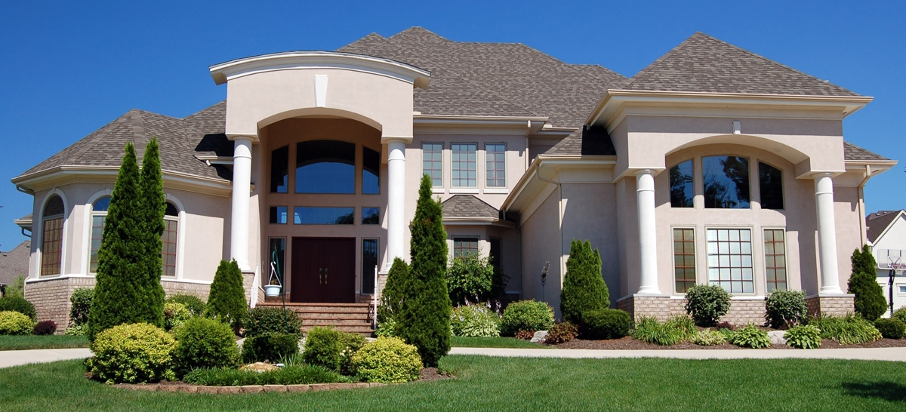
Questions?

